Slide 1


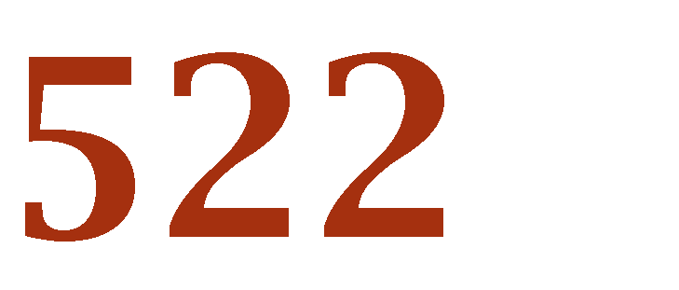


Lecture 05 – Unsupervised Learning
July 20, 2024

Slide 2
Cluster Analysis: Basic Concepts and Methods
Cluster Analysis: Basic Concepts
Partitioning Methods
Hierarchical Methods
Density-Based Methods
Summary
2
Notes:
2

Slide 3
What is Cluster Analysis?
Cluster: A collection of data objects
similar (or related) to one another within the same group
dissimilar (or unrelated) to the objects in other groups
Cluster analysis (or clustering, data segmentation, …)
Finding similarities between data according to the characteristics found in the data and grouping similar data objects into clusters
Unsupervised learning: no predefined classes (i.e., learning by observations vs. learning by examples: supervised)
Typical applications
As a stand-alone tool to get insight into data distribution
As a preprocessing step for other algorithms

Slide 4
Clustering as a Preprocessing Tool (Utility)
Summarization:
Preprocessing for regression, PCA, classification, and association analysis
Compression:
Image processing
Finding K-nearest Neighbors
Localizing search to one or a small number of clusters
Outlier detection
Outliers are often viewed as those “far away” from any cluster
Notes:
PCA: Principal Component Analysis

Slide 5
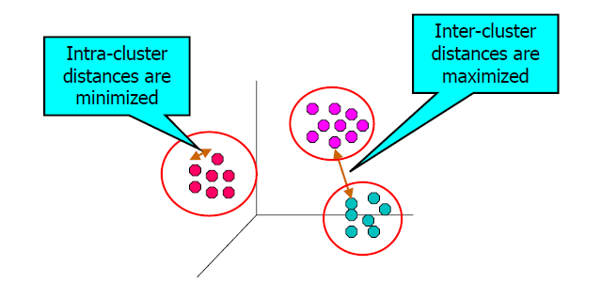
Quality: What Is Good Clustering?
A good clustering method will produce high quality clusters
high intra-class similarity: cohesive متماسك within clusters
low inter-class similarity: distinctive تميز between clusters
The quality of a clustering method depends on:
the similarity measure used by the method
its implementation, and
Its ability to discover some or all of the hidden patterns

Slide 6
Un-Supervising Learning
Cluster Analysis: Basic Concepts
Partitioning Methods
Hierarchical Methods
Density-Based Methods
Summary
Notes:
6

Slide 7
Partitional Clustering
Original Points
A Partitional Clustering

Slide 8
1-The K-Means Clustering Method
Given k, the k-means algorithm is implemented in four steps:
Partition objects into k nonempty subsets
Compute seed points as the centroids of the clusters of the current partitioning (the centroid is the center, i.e., mean point, of the cluster)
Assign each object to the cluster with the nearest seed point
Go back to Step 2, stop when the assignment does not change

Slide 9
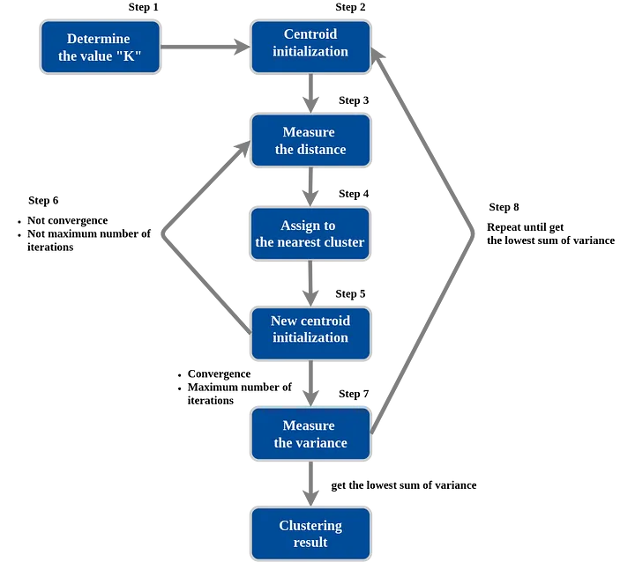
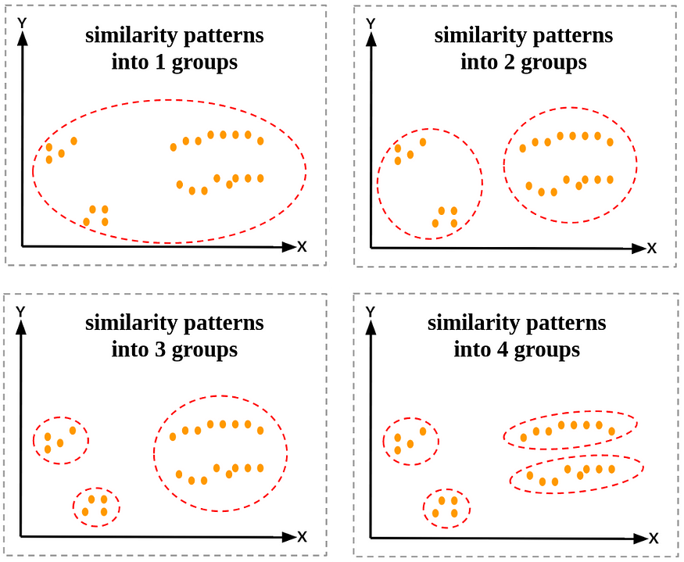
1-The K-Means Clustering Method … cont.
https://medium.com/data-folks-indonesia/step-by-step-to-understanding-k-means-clustering-and-implementation-with-sklearn-b55803f519d6

Slide 10
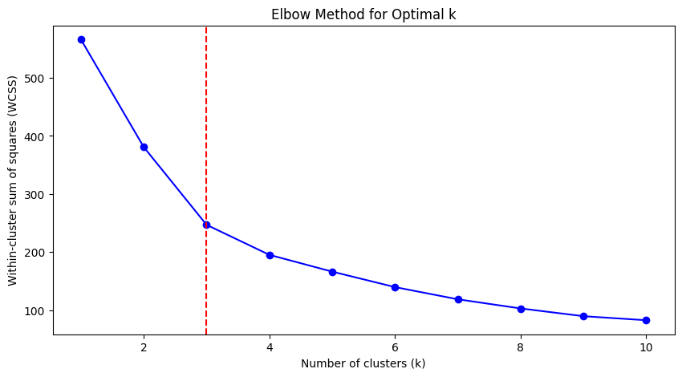

Slide 11
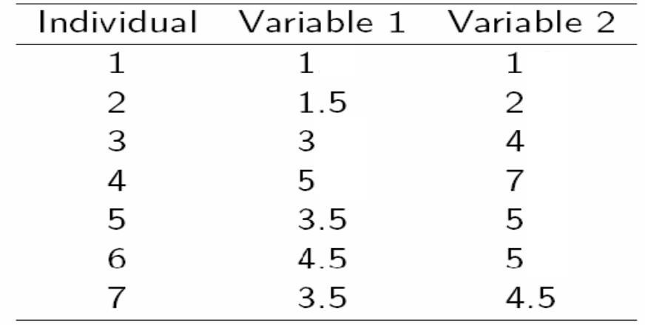
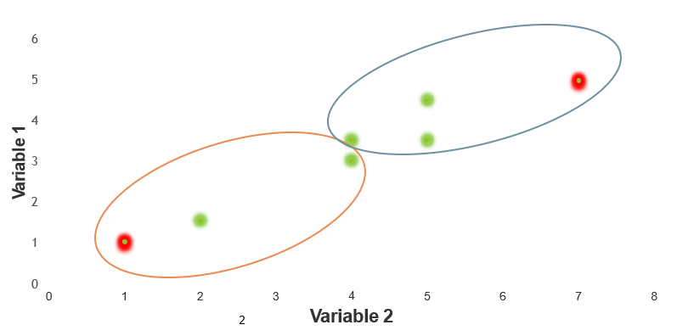
A Simple example k-means (using K=2)

Slide 12
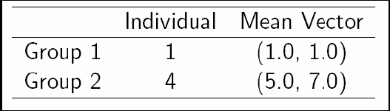
Step 1:
Initialization: Randomly we choose following two centroids (k=2) for two clusters. In this case the 2 centroid are: m1=(1.0,1.0) and m2=(5.0,7.0).

Slide 13
Step 2:
 | Centroid 1 |  |  |  |  |  |  | Centroid 2
1 | √( 1 | – 1 | )² | + | ( 1 – 1 | )² | = 0 | √( 5 | – 1 | )² | + | ( 7 | – 1 | )² | = 7.21
2 | √( 1 | – 1.5 | )² | + | ( 1 – 2 | )² | = 1.12 | √( 5 | – 1.5 | )² | + | ( 7 | – 2 | )² | = 6.10
3 | √( 1 | – 3 | )² | + | ( 1 – 4 | )² | = 3.61 | √( 5 | – 3 | )² | + | ( 7 | – 4 | )² | = 3.61
4 | √( 1 | – 5 | )² | + | ( 1 – 7 | )² | = 7.21 | √( 5 | – 5 | )² | + | ( 7 | – 7 | )² | = 0
5 | √( 1 | – 3.5 | )² | + | ( 1 – 5 | )² | = 4.72 | √( 5 | – 3.5 | )² | + | ( 7 | – 5 | )² | = 2.5
6 | √( 1 | – 4.5 | )² | + | ( 1 – 5 | )² | = 5.31 | √( 5 | – 4.5 | )² | + | ( 7 | – 5 | )² | = 2.06
7 | √( 1 | – 3.5 | )² | + | ( 1 – 4.5 | )² | = 4.30 | √( 5 | – 3.5 | )² | + | ( 7 | – 4.5 | )² | = 2.92

Slide 14
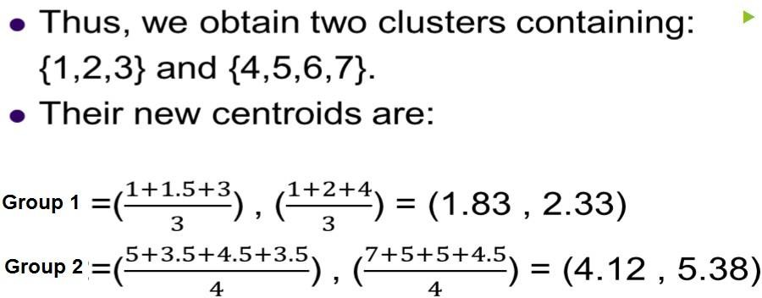
Step 2:

Slide 15
Step 3:
 | Centroid 1 |  |  |  |  |  |  |  | Centroid 2
1 | √( 1.83 | – 1 | )² | + | ( 2.33 | – 1 | )² | = 1.57 | √( 4.12 | – 1 | )² | + ( | 5.38 | – 1 | )² | = 5.38
2 | √(1.83 | – 1.5 | )² | + | (2.33 | – 2 | )² | = 0.47 | √( 4.12 | – 1.5 | )² | + ( | 5.38 | – 2 | )² | = 4.29
3 | √(1.83 | – 3 | )² | + | (2.33 | – 4 | )² | = 2.04 | √( 4.12 | – 3 | )² | + ( | 5.38 | – 4 | )² | = 1.78
4 | √(1.83 | – 5 | )² | + | (2.33 | – 7 | )² | = 5.64 | √( 4.12 | – 5 | )² | + ( | 5.38 | – 7 | )² | = 1.84
5 | √(1.83 | – 3.5 | )² | + | (2.33 | – 5 | )² | = 3.15 | √( 4.12 | – 3.5 | )² | + ( | 5.38 | – 5 | )² | = 0.73
6 | √(1.83 | – 4.5 | )² | + | (2.33 | – 5 | )² | = 3.78 | √( 4.12 | – 4.5 | )² | + ( | 5.38 | – 5 | )² | = 0.54
7 | √(1.83 | – 3.5 | )² | + | (2.33 | – 4.5 | )² | = 2.74 | √( 4.12 | – 3.5 | )² | + ( | 5.38 | – 4.5 | )² | = 1.08

Slide 16
Therefore, the new clusters are:
{1,2} and {3,4,5,6,7}
Group 1 =(^{𝟏+𝟏.𝟓}) , (^{𝟏+𝟐})
𝟐 𝟐
_{Group 2 =(}𝟑+𝟓+𝟑.𝟓+𝟒.𝟓+𝟑.𝟓_{) , (}𝟒+𝟕+𝟓+𝟓+𝟒.𝟓₎
𝟓 𝟓
=(1.25 , 1.5)
=(3.9 , 5.1)

Slide 17
Step 4:
 | Centroid 1 |  |  |  |  |  |  |  |  |  | Centroid 2
1 | √( 1.25 | – 1 | )² | + | ( 1.5 | – 1 | )² | = | 0.58 |  | √( 3.9 | – 1 | )² | + | ( 5.1 | – 1 | )² | = 5.02
2 | √(1.25 | – 1.5 | )² | + | (1.5 | – 2 | )² | = | 0.56 |  | √( 3.9 | – 1.5 | )² | + | ( 5.1 | – 2 | )² | = 3.92
3 | √(1.25 | – 3 | )² | + | (1.5 | – 4 | )² | = 3.05 |  |  | √( 3.9 | – 3 | )² | + | ( 5.1 | – 4 | )² | = 1.42
4 | √(1.25 | – 5 | )² | + | (1.5 | – 7 | )² | = 6.66 |  |  | √( 3.9 | – 5 | )² | + | ( 5.1 | – 7 | )² | = 2.20
5 | √(1.25 | – 3.5 | )² | + | (1.5 | – 5 | )² | = 4.16 |  |  | √( 3.9 | – 3.5 | )² | + | ( 5.1 | – 5 | )² | = 0.41
6 | √(1.25 | – 4.5 | )² | + | (1.5 | – 5 | )² | = 4.78 |  |  | √( 3.9 | – 4.5 | )² | + | ( 5.1 | – 5 | )² | = 0.61
7 | √(1.25 | – 3.5 | )² | + | (1.5 | – 4.5 | )² | = 3.75 |  |  | √( 3.9 | – 3.5 | )² | + | ( 5.1 | – 4.5 | )² | = 0.72
Therefore, there is no change in the cluster.
▶ Thus, the algorithm comes to a halt here and final result consist of 2 clusters {1,2} and
{3,4,5,6,7}.

Slide 18
The K-Means Advantages
Simplicity: K-means is easy to implement and understand, making it a popular choice for clustering tasks, especially for large datasets.
Efficiency: It is computationally efficient and works well with large datasets.
Scalability: K-means can handle large datasets with ease, making it suitable for clustering in big data applications.
Interpretability قابلة للتفسير: The clusters produced by k-means are easy to interpret, as each data point is assigned to the cluster with the nearest mean.
Versatility تنوع فى الداتا : K-means can be applied to various types of data, including numerical and categorical data, making it a versatile clustering algorithm.

Slide 19
The K-Means Disadvantages
Sensitive to Initial Centroids: K-means clustering is sensitive to the initial selection of cluster centroids, which can lead to different results for each run.
Assumes Spherical Clusters مجموعات كروية : K-means assumes that clusters are spherical and have similar sizes, which may not always hold true for real-world datasets with irregularly shaped clusters or clusters of varying sizes.
Requires Predefined Number of Clusters: The number of clusters (k) needs to be specified in advance, which may not always be known and choosing an inappropriate value for k can result in suboptimal clustering.
Outlier Sensitivity: K-means is sensitive to outliers, as they can disproportionately affect the positions of cluster centroids and the overall clustering result.
Non-Robust to Noise: K-means may produce poor results when dealing with noisy data or datasets with overlapping clusters.

Slide 20
Un-Supervising Learning
Cluster Analysis: Basic Concepts
Partitioning Methods
Hierarchical Methods
Density-Based Methods
Summary
Notes:
20

Slide 21
Hierarchical Clustering
Traditional Hierarchical Clustering
Traditional Dendrogram

Slide 22
2- Hierarchical Clustering
Hierarchical clustering is a method of cluster analysis that builds a hierarchy of clusters, use distance matrix as clustering criteria.
This method does not require the number of clusters k as an input, but needs a termination condition

Slide 23
Main types of hierarchical clustering
Agglomerative Clustering: This bottom-up approach begins with each data point as a separate cluster and then merges the closest pairs of clusters iteratively until only one cluster remains.
Divisive Clustering: This top-down approach starts with all data points in a single cluster and then recursively divides the dataset into smaller clusters until each cluster contains only one data point.
Step 0
Step 1
Step 2
Step 3
Step 4
agglomerative
(AGNES)
a
a b
b
a b c d e
c
c d e
d
d e
e
divisive
(DIANA)
Step 4
Step 3
Step 2
Step 1
Step 0

Slide 24
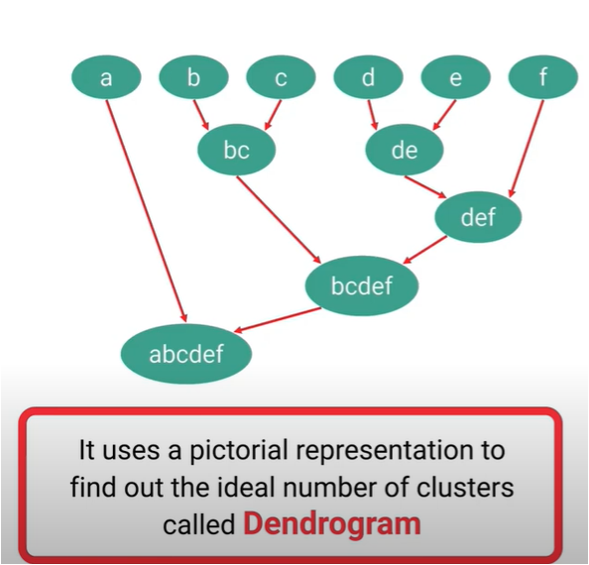
2-1 AGNES (Agglomerative Nesting)
Use the single-link (smallest distance between one point and cluster) method and the dissimilarity matrix
Merge nodes that have the least dissimilarity الاقل اختلافا
Go on in a Ascending fashion
Eventually all nodes belong to the same cluster
https://www.youtube.com/watch?app=desktop&v=k1ZU51B-33k

Slide 25
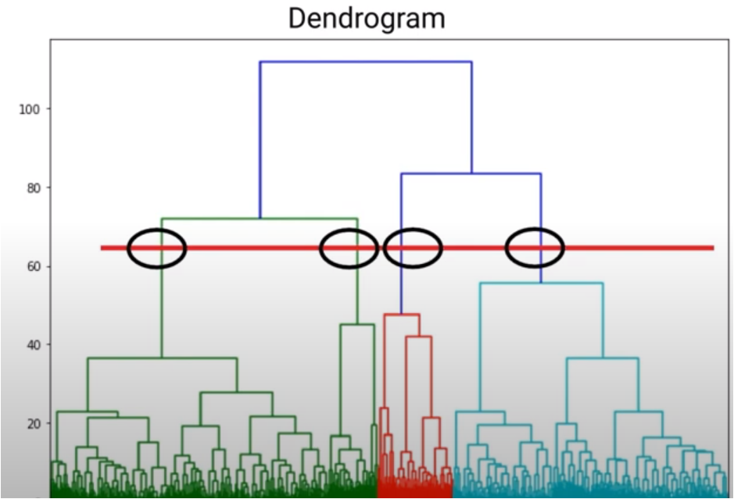
Dendrogram: Shows How Clusters are Merged
Decompose data objects into a several levels of nested partitioning (tree of clusters), called a dendrogram
A clustering of the data objects is obtained by cutting the dendrogram at the desired level, then each connected component forms a cluster
https://www.youtube.com/watch?app=desktop&v=k1ZU51B-33k

Slide 26
2-2 DIANA (Divisive Analysis)
Introduced in Kaufmann and Rousseeuw (1990)
Implemented in statistical analysis packages, e.g., Splus
Inverse order of AGNES
Eventually each node forms a cluster on its own

Slide 27
Distance between Clusters
X
X
Single link: smallest distance between an element in one cluster and an element in the other, i.e., dist(K_{i}, K_{j}) = min(t_{ip}, t_{jq})
Complete link: largest distance between an element in one cluster and an element in the other, i.e., dist(K_{i}, K_{j}) = max(t_{ip}, t_{jq})
Average: avg distance between an element in one cluster and an element in the other, i.e., dist(K_{i}, K_{j}) = avg(t_{ip}, t_{jq})
Centroids are the average of all points in the cluster and are not necessarily part of the data set.
medoids are actual data points that represent the center of the cluster.
Centroids are sensitive to outliers, while medoids are more robust to noise and outliers.
Centroids are typically used in K-means clustering, whereas medoids are used in K-medoids or PAM clustering.
Notes:
27

Slide 28
Un-Supervising Learning
Cluster Analysis: Basic Concepts
Partitioning Methods
Hierarchical Methods
Density-Based Methods
Notes:
28

Slide 29
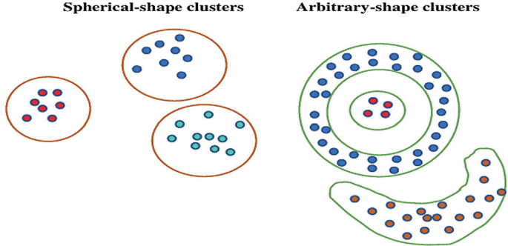

Slide 30
3-Density-Based Clustering Methods
Density-based clustering methods are algorithms used in machine learning and data mining to group data points based on their density in the feature space.
One of the most popular density-based clustering algorithms is DBSCAN (Density-Based Spatial Clustering of Applications with Noise).

Slide 31
Density-Based Clustering: Basic Concepts
In DBSCAN, we define two parameters:
Eps(epsilon): Maximum radius of the neighborhood
MinPts: Minimum number of points in an Eps- neighborhood of that point
NEps(q): {p belongs to D | dist(p,q) ≤ Eps}
Directly density-reachable: A point p is directly density-reachable from a point q w.r.t. Eps, MinPts if
p belongs to N_{Eps}(q)
core point condition:
|N_{Eps} (q)| ≥ MinPts
p
MinPts = 5
Eps = 1 cm
q

Slide 32
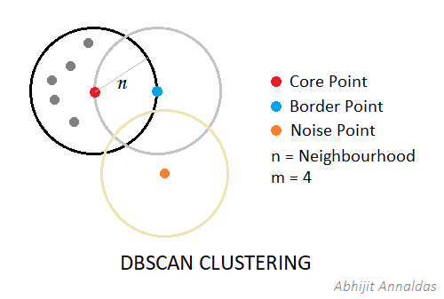

Slide 33
Density-Based Clustering: Cluster Formation
We start by randomly selecting a data point and examine its ε-neighborhood.
If the number of points within the ε-neighborhood exceeds the MinPts threshold, the point is labeled as a core point.
We then expand the cluster by iteratively examining the ε-neighborhood of each core point and adding its neighbors to the cluster.
If a core point's neighborhood contains other core points, their clusters are merged.
Border points, which are within the ε-neighborhood of a core point but do not have enough neighbors to be considered core points themselves, are assigned to the same cluster as their core point.
Points that are not core or border points are labeled as noise.

Slide 34
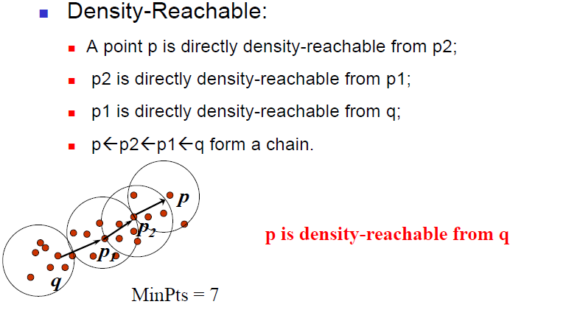
Density-reachability

Slide 35
Density-Reachable and Density-Connected
Density-reachable:
A point p is density-reachable from a point q w.r.t. Eps, MinPts if there is a chain of points p₁, …, p_{n}, p₁ = q, p_{n} = p such that p_{i+1} is directly density-reachable from p_{i}
Density-connected
A point p is density-connected to a point q w.r.t. Eps, MinPts if there is a point o such that both, p and q are density-reachable from o w.r.t. Eps and MinPts
p
p₁
q
p
q
o

Slide 36
Example:
Let's say ε = 0.1 (degrees) and MinPts = 4.
We start by selecting a random data point.
We then examine its ε-neighborhood (a circle with radius 0.1 degrees) and count the number of points within this neighborhood.
If there are at least 4 points within this neighborhood, the selected point is labeled as a core point, and its neighbors are added to the same cluster.
We continue this process, expanding clusters and merging them until all points are assigned to clusters or labeled as noise.

Slide 37
DBSCAN Example
https://www.kdnuggets.com/2020/04/dbscan-clustering-algorithm-machine-learning.html

Slide 38
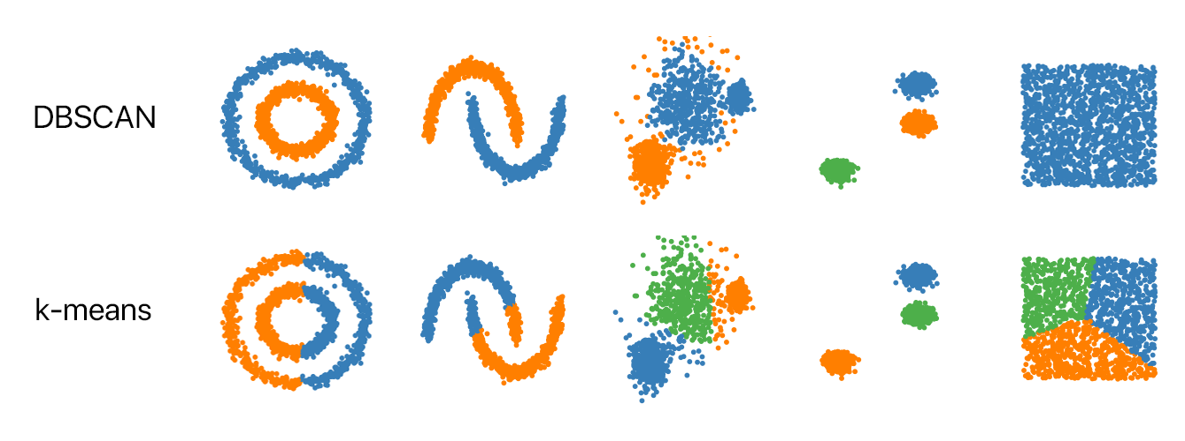

Slide 39
Summary
Cluster analysis groups objects based on their similarity and has wide applications
Measure of similarity can be computed for various types of data
Clustering algorithms can be categorized into partitioning methods, hierarchical methods, density-based methods, grid-based methods, and model-based methods
K-means and K-medoids algorithms are popular partitioning-based clustering algorithms
Birch and Chameleon are interesting hierarchical clustering algorithms, and there are also probabilistic hierarchical clustering algorithms
DBSCAN, OPTICS, and DENCLU are interesting density-based algorithms

Slide 40
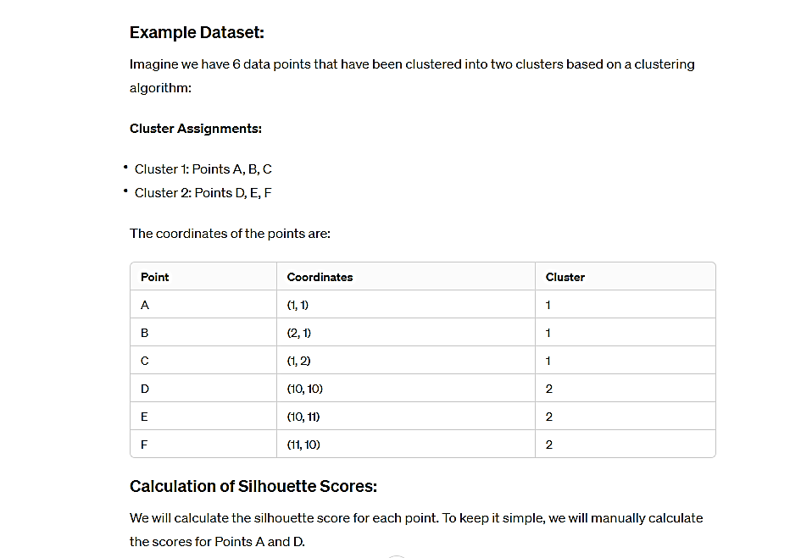
Silhouette score
The silhouette value is a measure of how similar an object is to its own cluster (cohesion) compared to other clusters (separation).
The silhouette ranges from −1 to +1, where a high value indicates that the object is well matched to its own cluster and poorly matched to neighboring clusters.

Slide 41
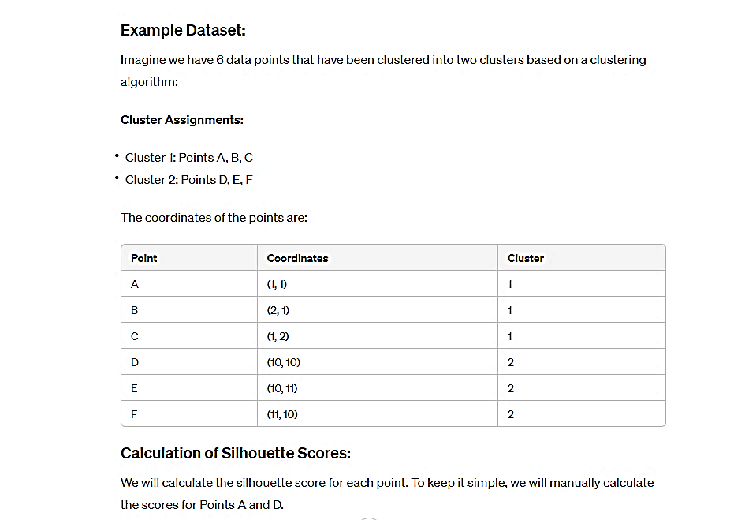
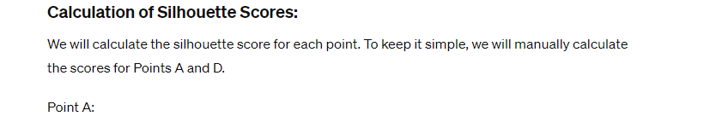
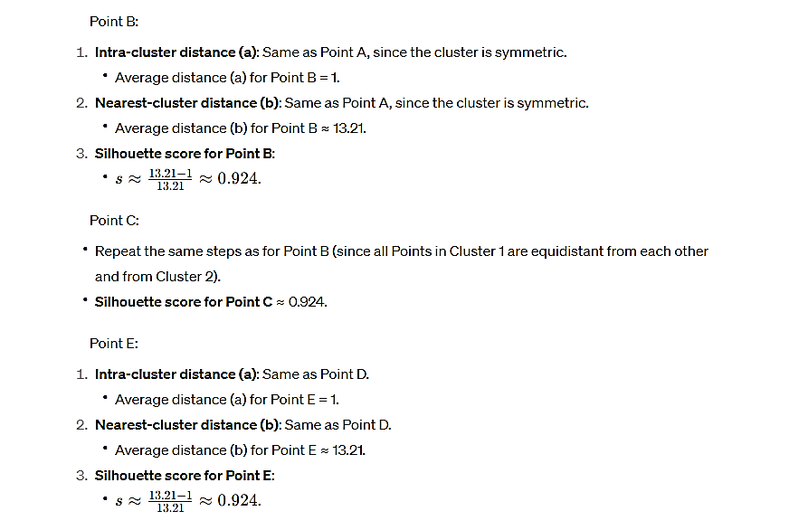
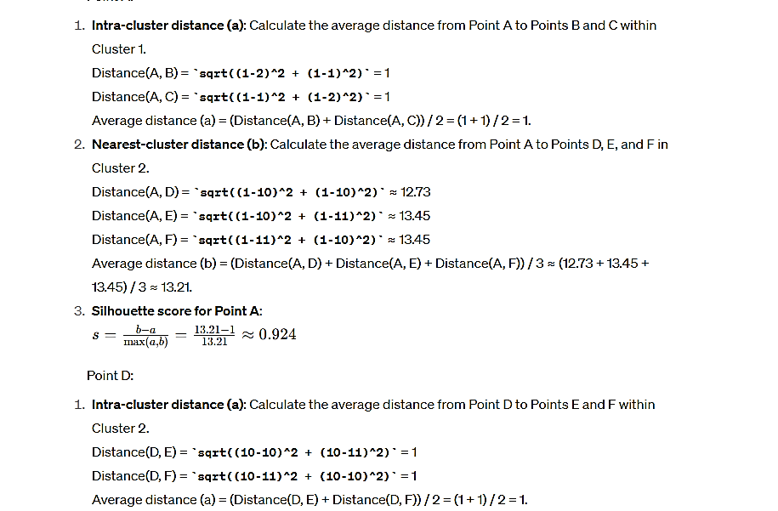

Slide 42
